Slide 1

E••i •y•c Data Analysis using Excel
STUDENT NAME: SWETHA. B REGISTER NO: 122202100 DEPARTMENT: B COM (CS) 3B
COLLEGE : ANNA ADARSH COLLEGE FOR. WOMEN

Slide 2


Employee Performance Analysis
using Excel
PROJECT TITLE

Slide 3

AGENDA
l.Problem Statement
Project Overview
End Users
Our Solution and Proposition
Dataset Description
Modelling Approach
Results and Discussion
Conclusion

Slide 4
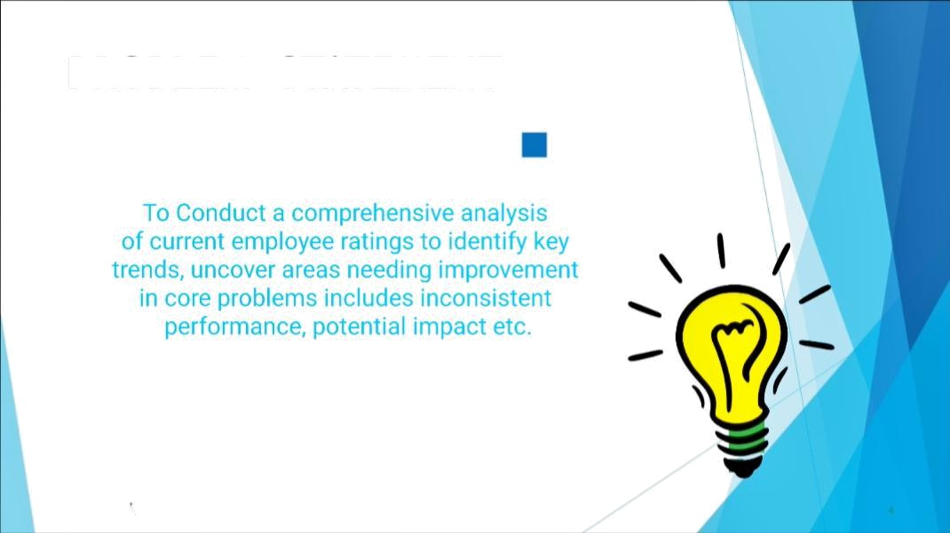
PROBLEM STATEMENT

Slide 5

WHO ARE THE END USERS?
HR Managers To access overall employee performance trends identify training needs and use case metrics
for recruitment and retention strategies.
Departmenl Heads: Use performance data to set goals.
Performance Analysts: Generate reports and recommendation for opt musing the performance management process.

Slide 6

OUR SOLUTION AND ITS YALUE PROPOSITION
Sorting- Arrange in the Ascending Order
Filtering- Filling, Adjusting columns Conditional Formatting- Highest To Lowest Pivot Chart- Summary Of Employee Performance Formuas-Exce|Formuas

Slide 7

Dataset Description

Slide 8
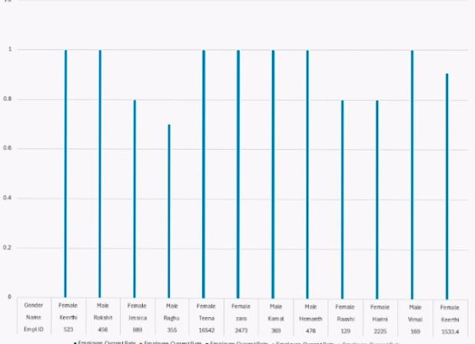
Cende
-fs
Enoti

Slide 9

MODELLING
Data Ser employee dataset
Feature selection work location
Data Cleaning missing value, irrelevant
Formula-performance calculation, low, medium, hiqh, sum
Pivot table and chart summary.

Slide 10
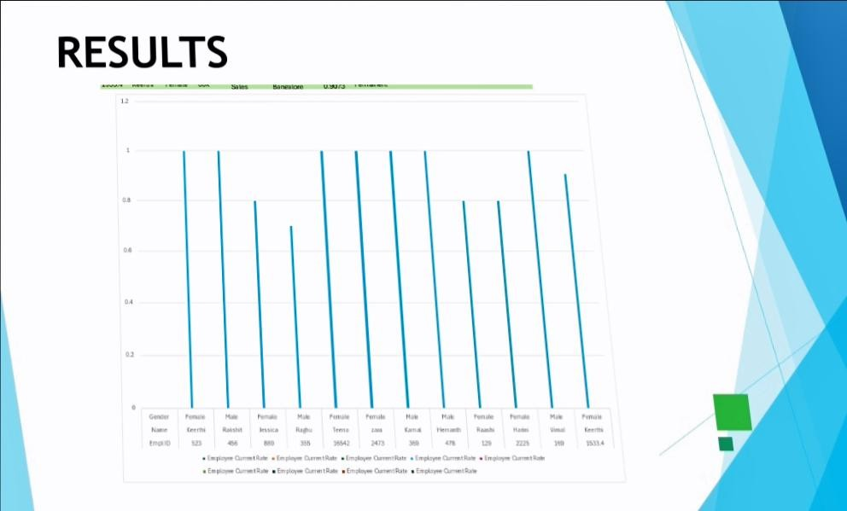
RESULTS
Baneioe
Penue
emale
Hae
eme
imaie
Nae
Ieerth
Raisht
jessica
Teme
Kana
ema
Hanes
6542
4T
1S334
impioe GammtRa fnpl GrmtRat Employ ORatr Emploee CantRa impiye atRat
Emploe QumetRa Employ CrtRae Engly CanRate EmpeCunntRa

Slide 11
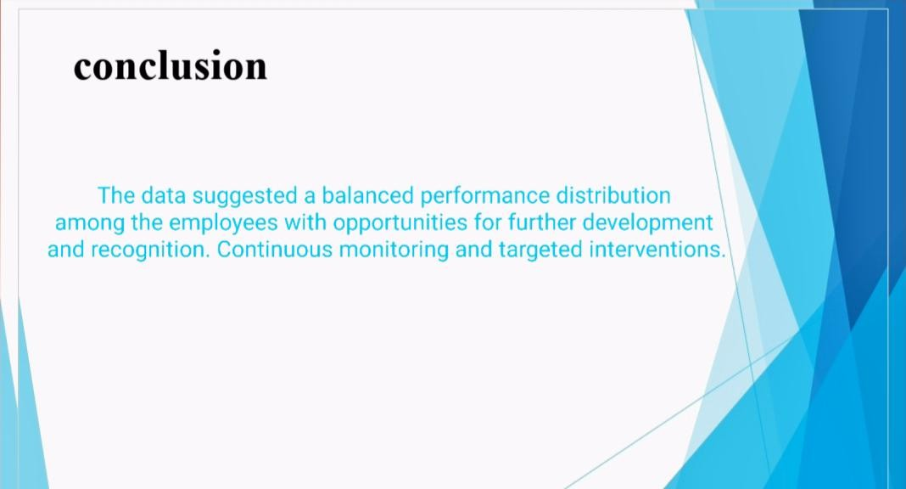
conclusion
The data suggested a balanced
performance distribution
among the employees with opportunities for furtherdevelopment
and recognition.Continuous monitoring and targeted interventions.

